Slide 1
Machine Learning
MATH42815
Friday January 26th 2024

Slide 2
Week 3
Practical 7:
CART algorithm
Lecture 5:
Pruning decision trees
Bootstrap, boosting, and bagging
Practicals 8 and 9:
Random forest
Lecture 6:
Neural Networks 1

Slide 3
Lecture 6 Outline
Optimization versus Learning
Machine Learning versus Deep Learning
Deep Feedforward Networks
Hidden Layers
Example: XOR
Early Stopping
Back-Propagation
Image Processing
Fundamentals of Convolutional Neural Networks
Adversarial Training

Slide 4
Optimization versus Learning

Slide 5
What is Learning?
Optimization:
Define cost function
Find solution to minimize cost function for training data
Learning:
Find solution to reach a targeted level of prediction accuracy
Depending on specific machine learning task, may involve finding a local minimum of cost function
Unlikely to ever consider pressing for a global minimum
May also look to improve cost function that will correlate with improved prediction accuracy

Slide 6
Regularization
“Any modification we make to a learning algorithm that is intended to reduce its generalization error but not its training error”
Who can think of a process that might not find the “true” solution but will find a consistently pretty good one?
Ridge and/or Lasso Regression! (Elastic Net Regression)

Slide 7
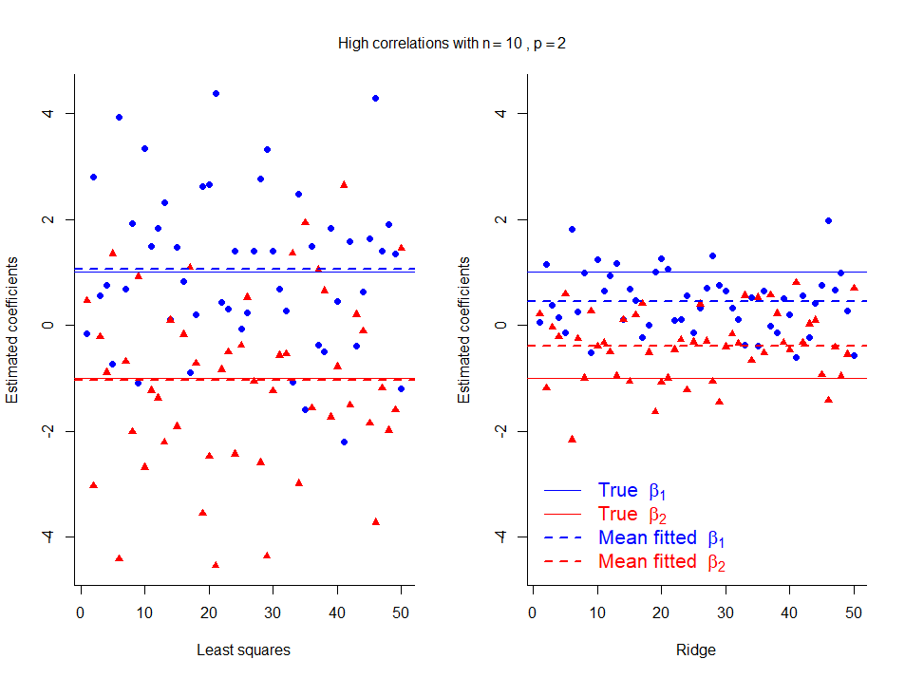
Ridge Regression Introduces Bias, Reduces Variance
Small data set (n=10)
Strong multicollinearity
Can improve test error
→ better prediction at a cost of interpretability!

Slide 8
Machine Learning versus Deep Learning

Slide 9
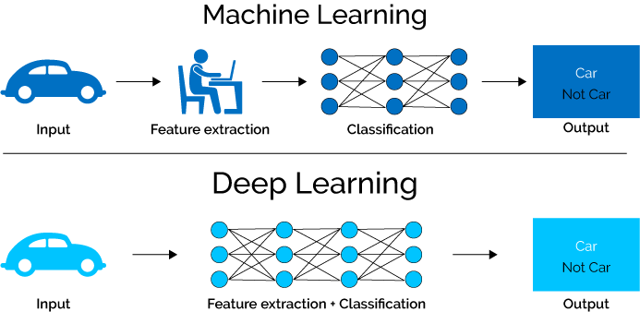
Machine Learning versus Deep Learning
https://hackernoon.com/log-analytics-with-deep-learning-and-machine-learning-20a1891ff70e

Slide 10
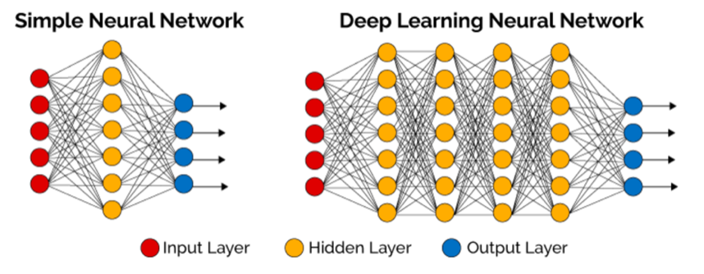
Schematic of Deep Neural Network
https://hackernoon.com/log-analytics-with-deep-learning-and-machine-learning-20a1891ff70e

Slide 11
Why Use “Neurons”?
Independent, non-linear behaviour in parallel can achieve powerful results!
Not necessarily useful results – remember the tiger enclosure!

Slide 12
Deep Learning, Figure 7.5
Technically: Bagging example
However, illustrates “parallel benefit” neatly!

Slide 13

Goal of Deep Learning: Learn The Mapping
Learn mapping $φ$ to change input/feature variables x into a form that can then be mapped to output y
For extra detail: see Chapter 6 of Deep Learning by Goodfellow, Bengio, and Courville

Slide 14
Deep Feedforward Networks

Slide 15
Schematic of Deep Neural Network
https://hackernoon.com/log-analytics-with-deep-learning-and-machine-learning-20a1891ff70e

Slide 16
Note: Categorical Variables Must Be One-Hot Coded!
In ISDS and earlier in this module, we used dummy variables to represent categorical variables
Reference category
Every other category defined in relation to reference category
Even interactions can work this way
For Deep Learning to work properly, categorical variables must be one-hot coded
Include a specific variable for every category
Each observation must belong to precisely one category

Slide 17
Example: Dummy Variables vs. One-Hot Coded
Age | <18 | 65+
18-64 | 0 | 0
<18 | 1 | 0
18-64 | 0 | 0
65+ | 0 | 1
18-64 | 0 | 0
Age | <18 | 18-64 | 65+
18-64 | 0 | 1 | 0
<18 | 1 | 0 | 0
18-64 | 0 | 1 | 0
65+ | 0 | 0 | 1
18-64 | 0 | 1 | 0

Slide 18
Hidden Layers

Slide 19
Hidden Layers and Hidden Units
Generally: combines affine transformation with non-linear activation function
Affine transformation: Transformations discussed as matrix-vector multiplication in IMDS
Often written as weights W and biases c, with W^{T}x + c as input to…
Non-linear activation function:
A function, which is not linear
Linear functions can only represent linear (or approximately linear) behaviour
Activation function is what allows non-linear behaviour to be captured

Slide 20
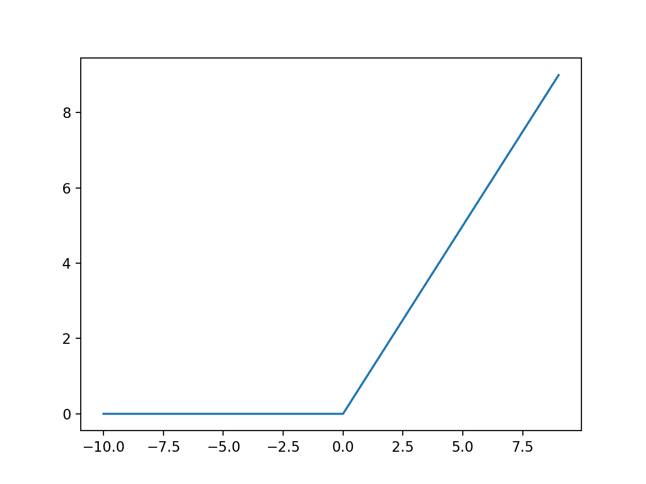
RELU: Rectified Linear Unit
https://machinelearningmastery.com/rectified-linear-activation-function-for-deep-learning-neural-networks/

Slide 21
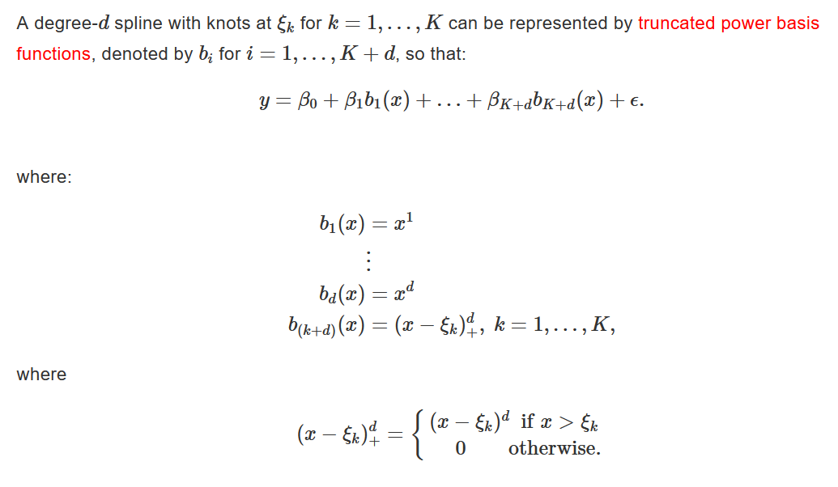

Spline Basis Representation: Theory
$$ξ_{k}=0$$
$$d=1$$

Slide 22
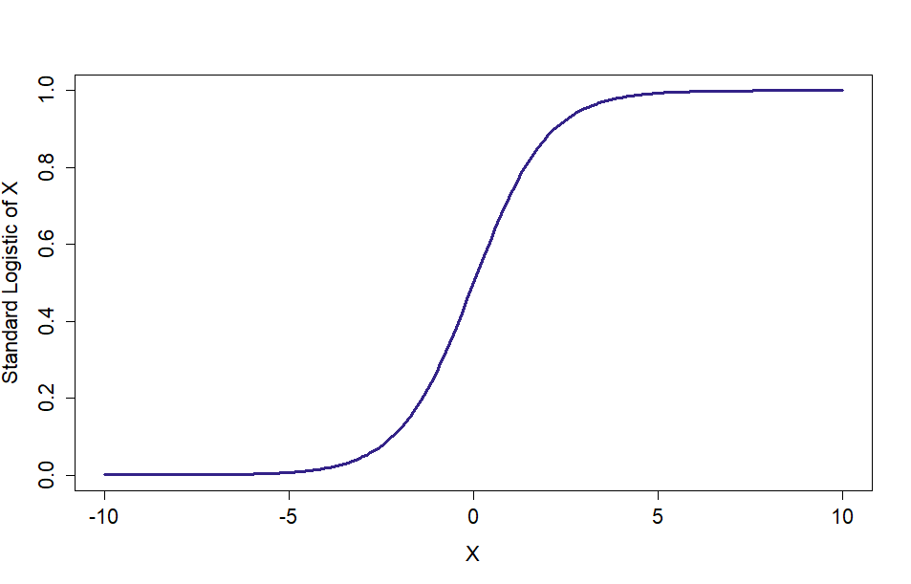
Graph of Logistic Function

Slide 23
Example: XOR

Slide 24
Example from Section 6.1, Deep Learning
X1 | X2 | X1 (XOR) X2
TRUE | TRUE | FALSE
TRUE | FALSE | TRUE
FALSE | TRUE | TRUE
FALSE | FALSE | FALSE
X1 | X2 | X1 (XOR) X2
1 | 1 | 0
1 | 0 | 1
0 | 1 | 1
0 | 0 | 0

Slide 25
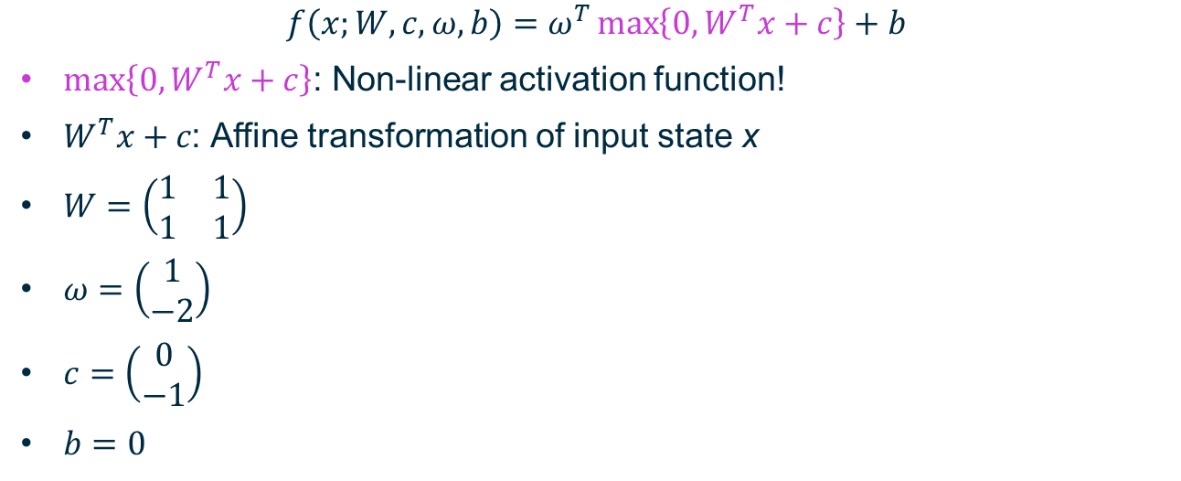

Neural Network to Reproduce XOR
$$f\left(x;W,c,ω,b\right)=ω^{T}\max\left\{0,W^{T}x+c\right\}+b$$
$\max\left\{0,W^{T}x+c\right\}$: Non-linear activation function!
$W^{T}x+c\text{: }$Affine transformation of input state x
$W=\left(\begin{matrix}1 & 1 \\ 1 & 1\end{matrix}\right)$
$ω=\left(\begin{matrix}1 \\ −2\end{matrix}\right)$
$c=\left(\begin{matrix}0 \\ −1\end{matrix}\right)$
$b=0$
Combined: hidden layer!

Slide 26
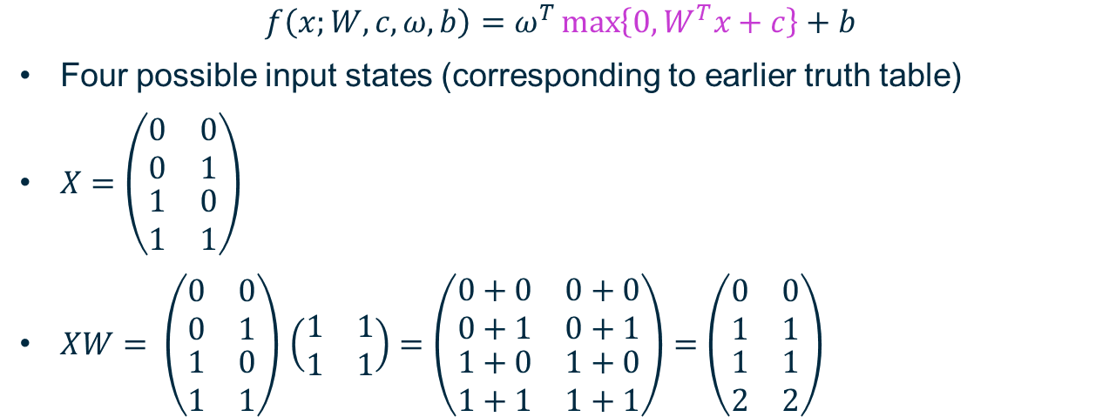
Bring in Design Matrix!
$$f\left(x;W,c,ω,b\right)=ω^{T}\max\left\{0,W^{T}x+c\right\}+b$$
Four possible input states (corresponding to earlier truth table)
$X=\left(\begin{matrix}0 & 0 \\ 0 & 1 \\ \begin{matrix}1 \\ 1\end{matrix} & \begin{matrix}0 \\ 1\end{matrix}\end{matrix}\right)$
$XW= \left(\begin{matrix}0 & 0 \\ 0 & 1 \\ \begin{matrix}1 \\ 1\end{matrix} & \begin{matrix}0 \\ 1\end{matrix}\end{matrix}\right)$ $\left(\begin{matrix}1 & 1 \\ 1 & 1\end{matrix}\right)=\left(\begin{matrix}0+0 & 0+0 \\ 0+1 & 0+1 \\ \begin{matrix}1+0 \\ 1+1\end{matrix} & \begin{matrix}1+0 \\ 1+1\end{matrix}\end{matrix}\right)=\left(\begin{matrix}0 & 0 \\ 1 & 1 \\ \begin{matrix}1 \\ 2\end{matrix} & \begin{matrix}1 \\ 2\end{matrix}\end{matrix}\right)$

Slide 27
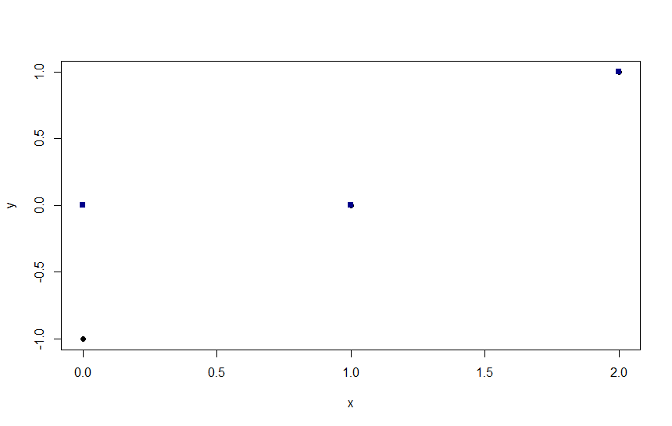
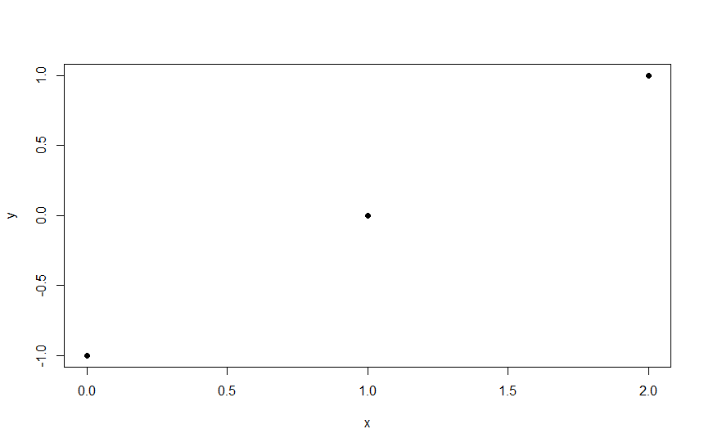

Add the bias vector c and apply activation function
$XW+c=\left(\begin{matrix}0 & 0 \\ 1 & 1 \\ \begin{matrix}1 \\ 2\end{matrix} & \begin{matrix}1 \\ 2\end{matrix}\end{matrix}\right)+$ $\left(\begin{matrix}0 & −1 \\ 0 & −1 \\ \begin{matrix}0 \\ 0\end{matrix} & \begin{matrix}−1 \\ −1\end{matrix}\end{matrix}\right)=\left(\begin{matrix}0 & −1 \\ 1 & 0 \\ \begin{matrix}1 \\ 2\end{matrix} & \begin{matrix}0 \\ 1\end{matrix}\end{matrix}\right)$
$\max\left\{0,W^{T}x+c\right\}$:
$\left(\begin{matrix}0 & −1 \\ 1 & 0 \\ \begin{matrix}1 \\ 2\end{matrix} & \begin{matrix}0 \\ 1\end{matrix}\end{matrix}\right) →\left(\begin{matrix}0 & 0 \\ 1 & 0 \\ \begin{matrix}1 \\ 2\end{matrix} & \begin{matrix}0 \\ 1\end{matrix}\end{matrix}\right)$

Slide 28

Multiply by weight vector w
$\left(\begin{matrix}0 & 0 \\ 1 & 0 \\ \begin{matrix}1 \\ 2\end{matrix} & \begin{matrix}0 \\ 1\end{matrix}\end{matrix}\right)\left(\begin{matrix}1 \\ −2\end{matrix}\right)=\left(\begin{matrix}0+0 \\ 1+0 \\ \begin{matrix}1+0 \\ 2−2\end{matrix}\end{matrix}\right)$ $=\left(\begin{matrix}0 \\ 1 \\ \begin{matrix}1 \\ 0\end{matrix}\end{matrix}\right)$
Go from $X=\left(\begin{matrix}0 & 0 \\ 0 & 1 \\ \begin{matrix}1 \\ 1\end{matrix} & \begin{matrix}0 \\ 1\end{matrix}\end{matrix}\right)$to $\left(\begin{matrix}0 \\ 1 \\ \begin{matrix}1 \\ 0\end{matrix}\end{matrix}\right)$
X1 | X2 | X1 (XOR) X2
1 | 1 | 0
1 | 0 | 1
0 | 1 | 1
0 | 0 | 0

Slide 29
Early Stopping

Slide 30
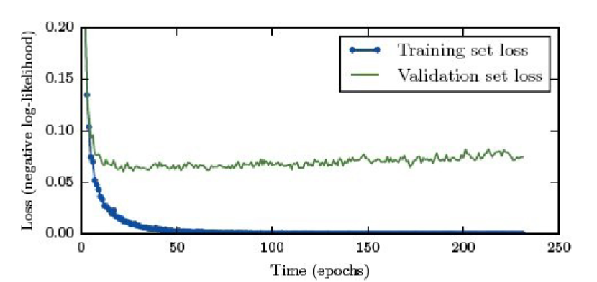
Figure 7.3, Deep Learning

Slide 31
Back Propagation

Slide 32
Back Propagation
Still want to minimize some kind of objective function
When we have created our whole neural network, we can work backwards to find derivatives related to our affine functions (or weights and biases) and our activation functions
We cannot directly calculate these for hidden layers because they are hidden (i.e. unknown)
However, we can calculate for the output layer…and then it turns out we can reverse-engineer the whole set of derivatives going backwards.
Source for images

Slide 33
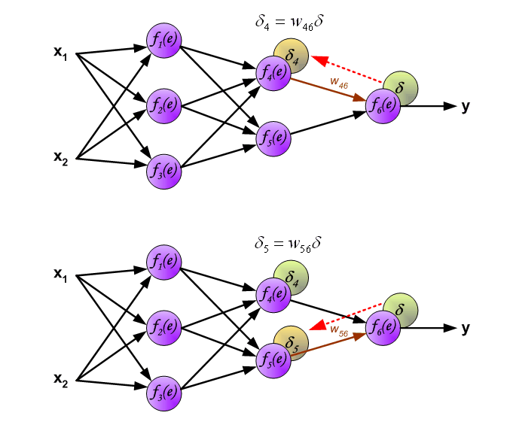
Use Formulae to Determine Which Neurons Cause Most Error

Slide 34
Image Processing

Slide 35
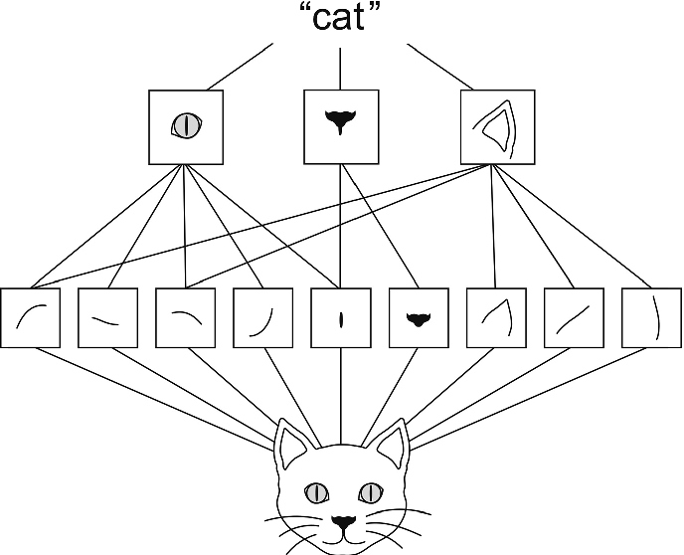
Identifying “Features” and Categorising
Figure 1, Themes Validation Tool, Fernandes et al., https://link.springer.com/chapter/10.1007/978-3-030-30712-7_3

Slide 36

What Is This (4)?

Slide 37
Fundamentals of Convolutional Neural Networks

Slide 38
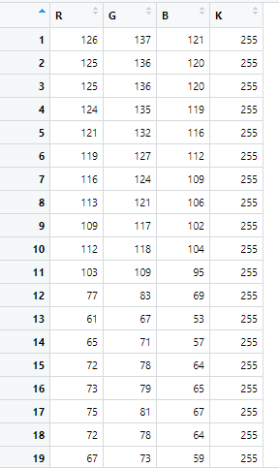
What Is This (2)?

Slide 39
0 = Black
255 = White

Slide 40
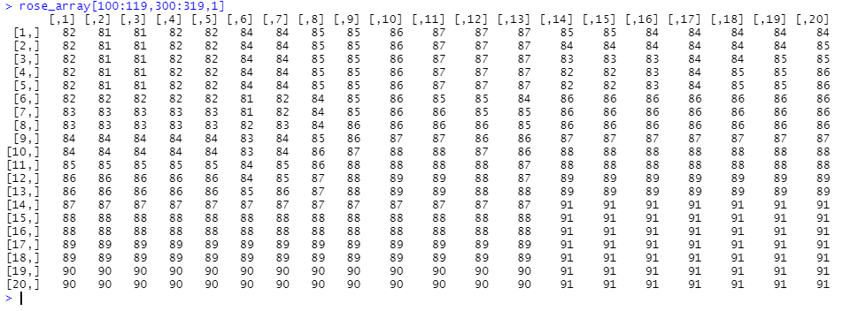
Pixel Values from Rose Image

Slide 41
Convolution: Define a Kernel
Matrix which is applied repeatedly to the whole image to extract features

Slide 42
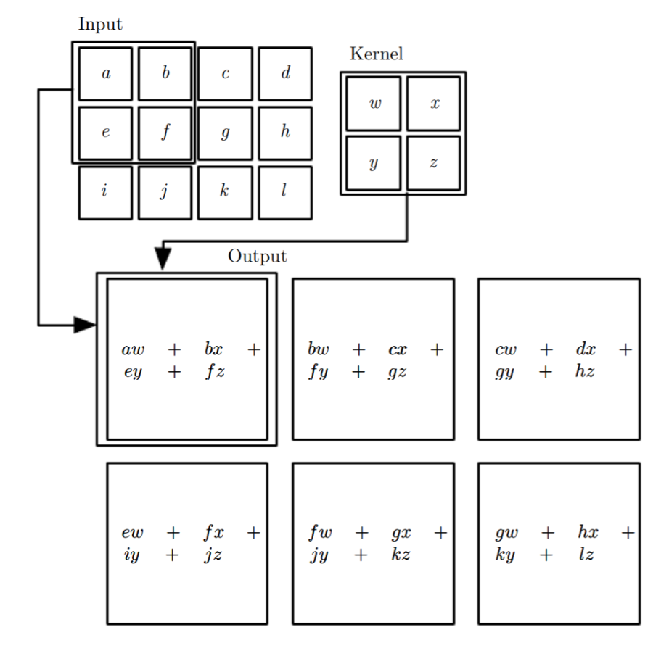
Figure 9.1, Deep Learning

Slide 43
Convolution: Define a Kernel
Matrix which is applied repeatedly to the whole image to extract features
Simplest possible example:
(-1, 1): Subtract previous pixel’s value from current pixel’s value (horizontally)
If large difference, implies a major change in image between those two pixels
For more details, see Chapter 9 of Deep Learning
In R, the following example only used Magick

Slide 44


Slide 45


Slide 46
Identifying “Features” and Categorising
Figure 1, Themes Validation Tool, Fernandes et al., https://link.springer.com/chapter/10.1007/978-3-030-30712-7_3

Slide 47
Adversarial Training

Slide 48
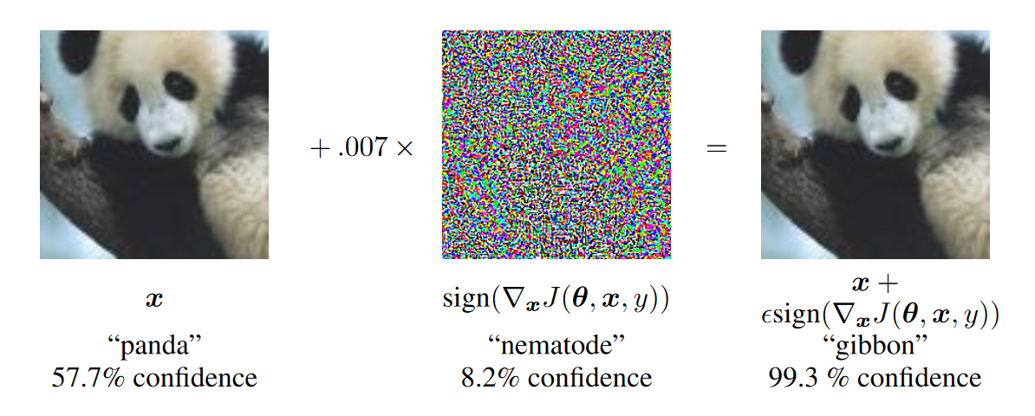
Efficiently Improve Your (Supervised) Model
https://arxiv.org/pdf/1412.6572.pdf

Slide 49
Machine Learning versus Deep Learning
https://hackernoon.com/log-analytics-with-deep-learning-and-machine-learning-20a1891ff70e

Slide 50
Summary

Slide 51
Lecture 6 Summary
“Learning” more about outcome than process
Sometimes bias is preferable to variance
Including parallel, non-linear processes makes deep learning very powerful
“Good Enough” better than “Perfectly Trained”
XOR example of hidden layer behaviour
How computers evaluate features in images
The benefits of adversarial training

